Slide 1
Custom Mechanical Keyboards Tutorial

Slide 2
Why we need a custom mechanical keyboard rather than normal mechanical keyboard?
Sounds & Press Feeling (Switches, Position Plate, Satellite Axis, etc.)
Appearance & Personality (Keyboard Style, Keyboard Color, Keycaps, etc.)
Special Function (OLED Screen, RGB LED Control, etc.)

Slide 3
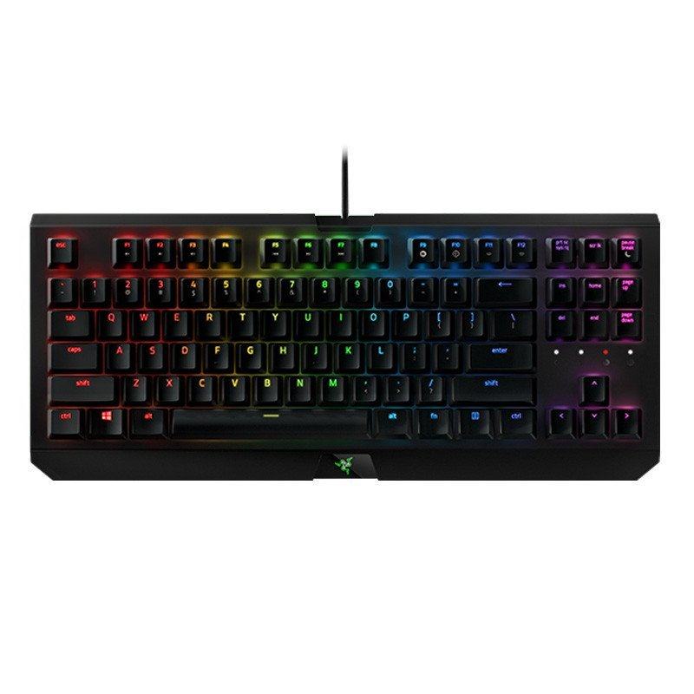
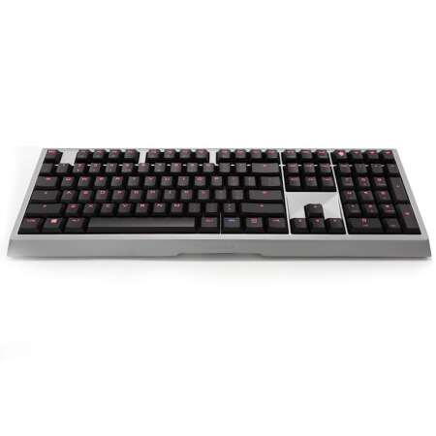
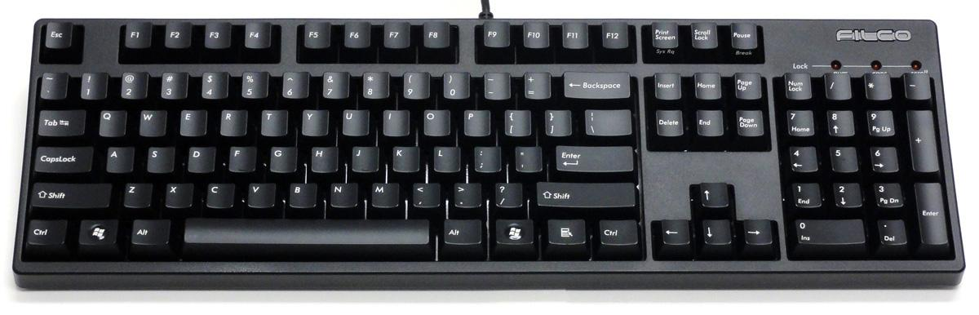
Regular Mechanical Keyboard
Cherry MX6.0
Razer BlackWidow
FILCO Majestouch 2
Leopold FC750R PD CHARCOAL BLUE ENG

Slide 4
Pearl 40%
IC: Interest Check

Slide 5
Cyberboard

Slide 6
Matrix abelx eva-01

Slide 7
Matrix abelx eva-penpen
IC: Interest Check

Slide 8
Canoe Gen 2 eva

Slide 9
Tiamo V2 - TI

Slide 10
What composes a mechanical keyboard?
Mechanical Keyboard Kit (Frame, PCB, Poron, Position Plate, Decorations, etc)

Slide 11
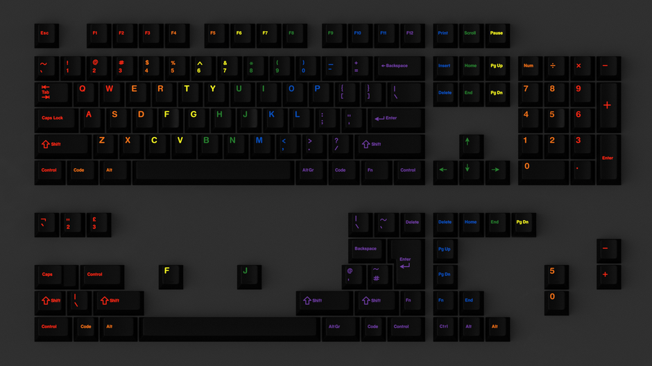
What composes a mechanical keyboard?
Keycaps
EPBT 9009
GMK midnight rainbow

Slide 12
What composes a mechanical keyboard?
Switches
EVA-01 switch (Linear 63.5g)
EQUALZ Kiwi switch (Tactile 67g)

Slide 13
Mechanical Keyboard Kit – Frame
There are three mainstream structure of Mechanical Keyboard:
Tray mount
Top mount
Gasket mount

Slide 14
Tray mount
Merit: Cheap, Compatible;
Defect: Unstable, Inconsistent;

Slide 15
Top mount
Merit: Consistent, Stable;
Defect: Incompatible, Expensive;

Slide 16
Gasket mount
Merit: Relatively Consistent, Relatively Stable, Wonderful Sound;
Defect: Incompatible, Very Expensive (high process precision require);

Slide 17
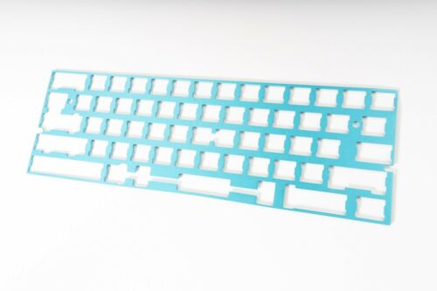
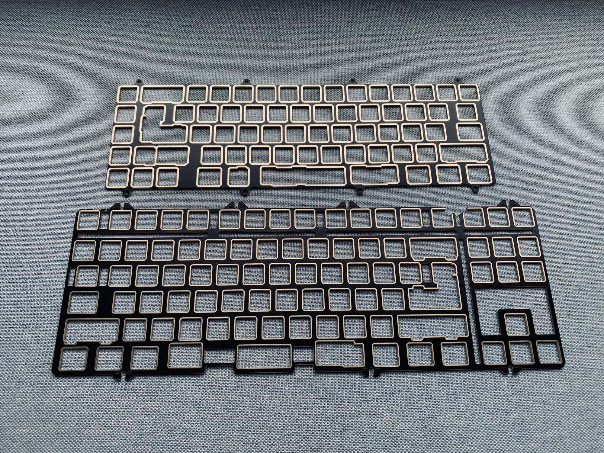
Mechanical Keyboard Kit – Position Plate
There are many types of position plate:
Copper Position Plate
Aldine Position Plate
Carbon Fiber Plate
Glass Fiber Plate
1
2
3
4

Slide 18
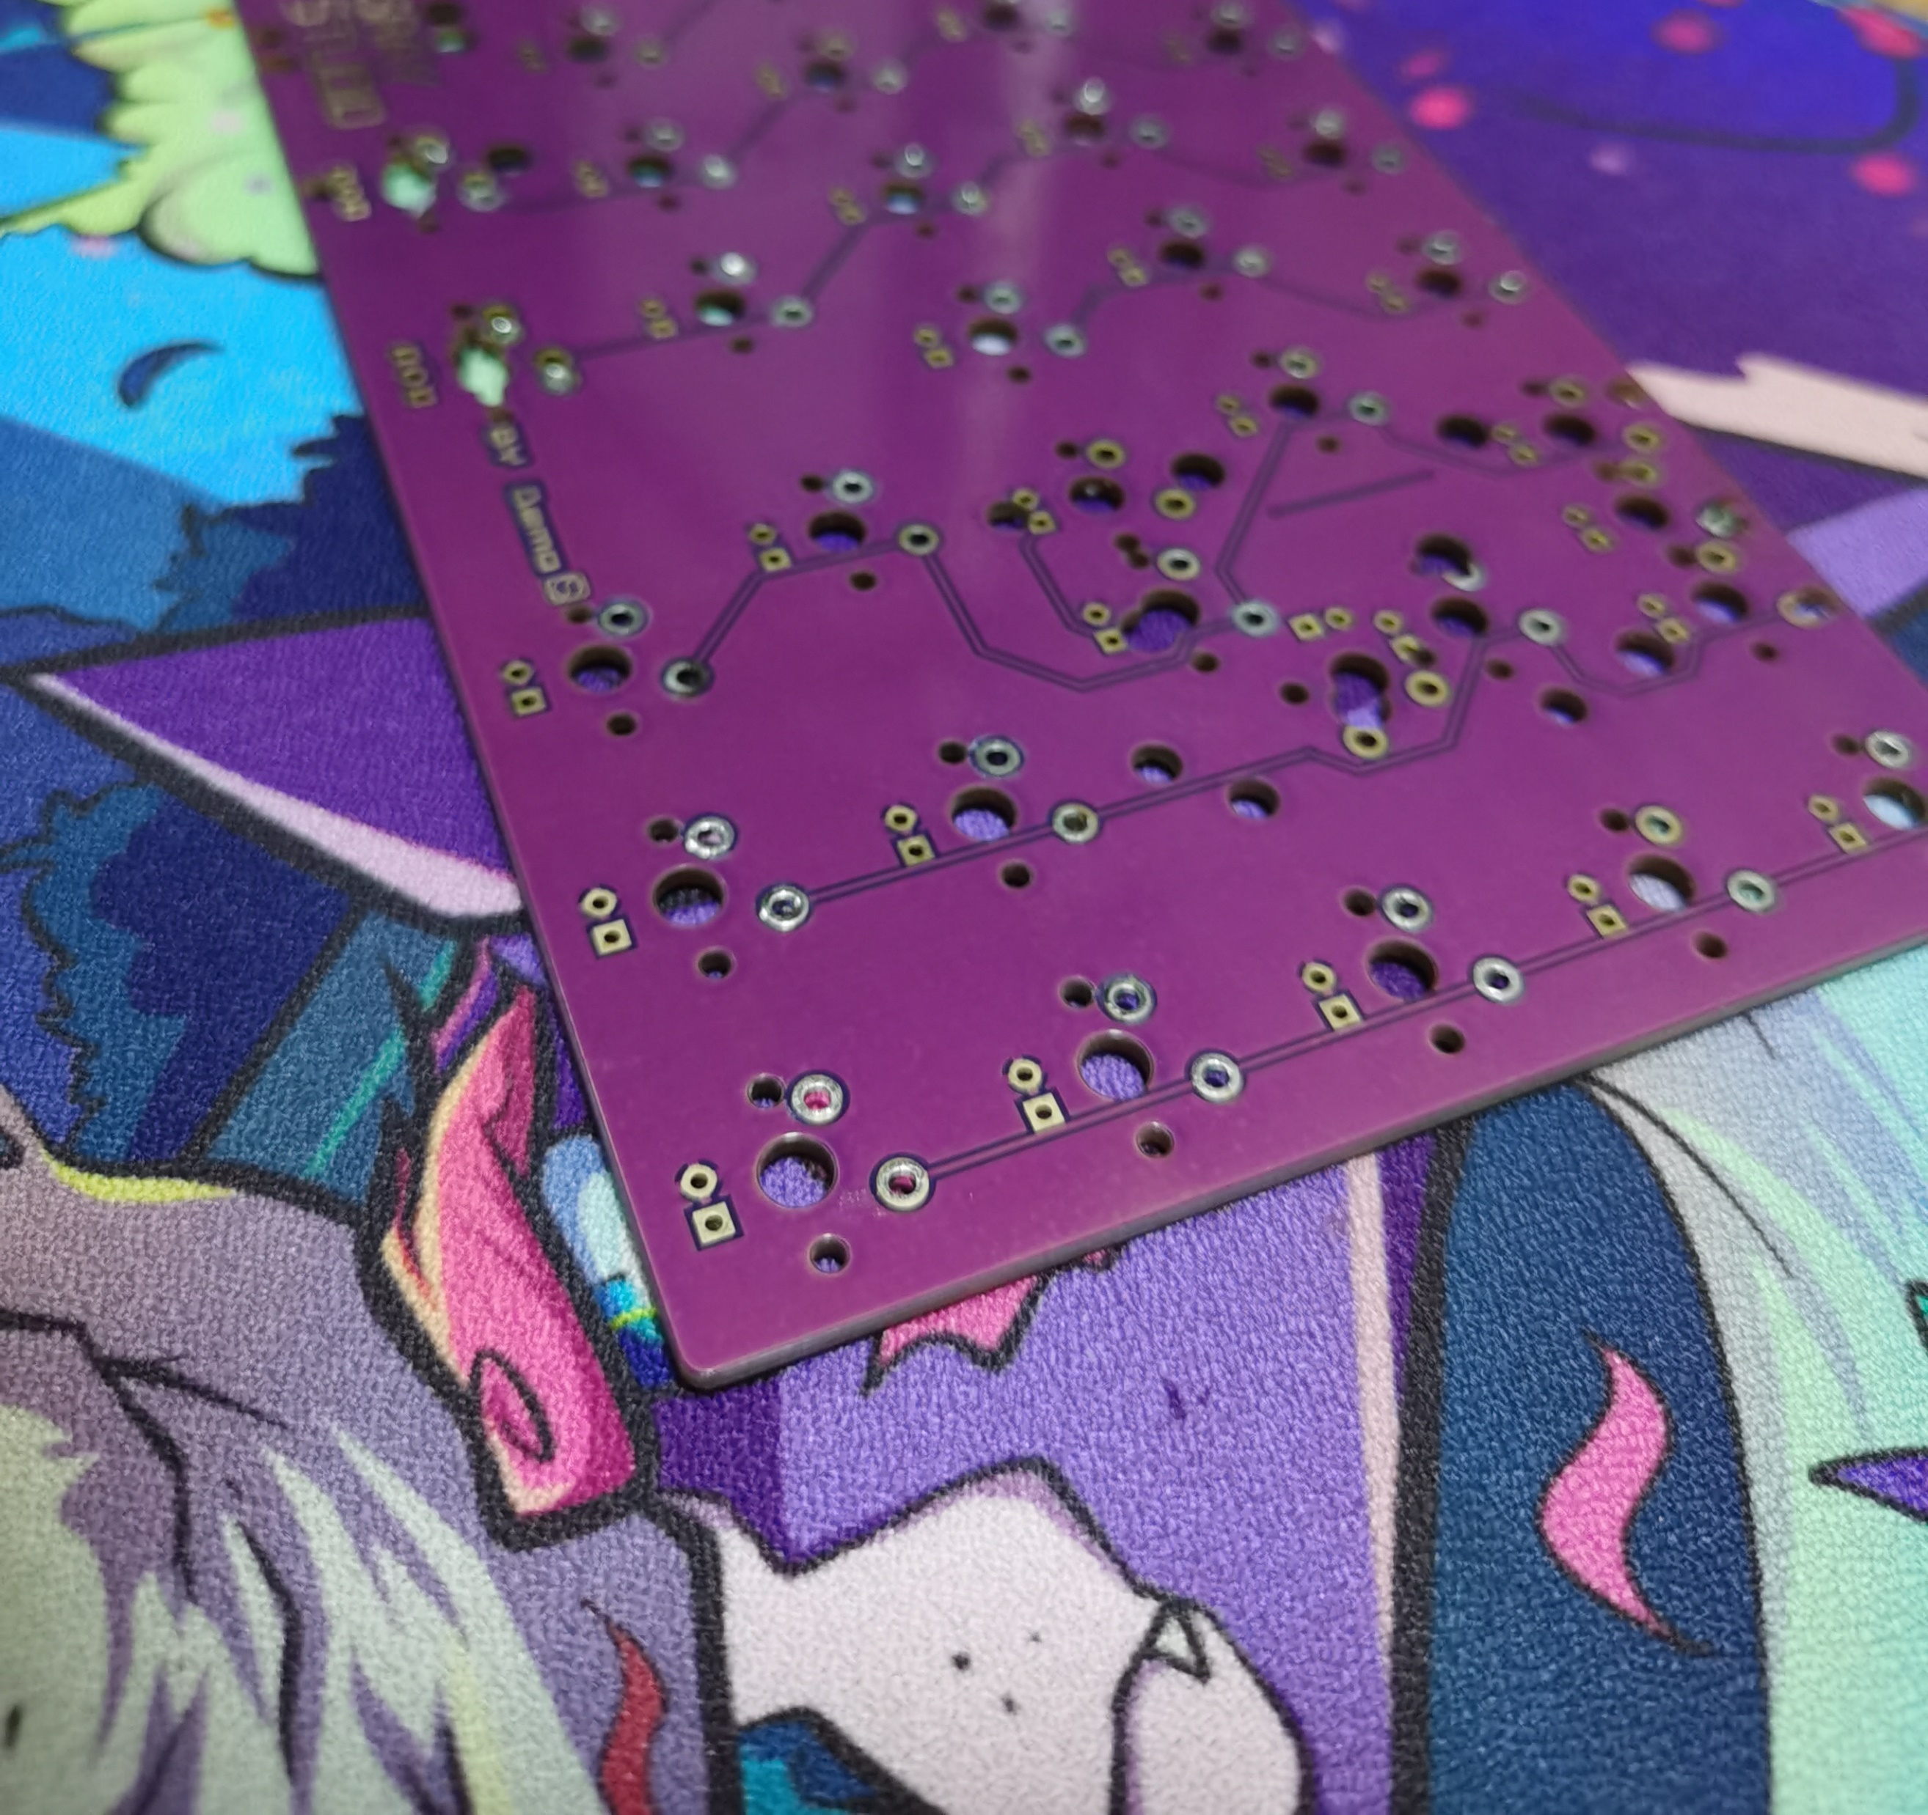
Mechanical Keyboard Kit – PCB
PCB has two types: hotswap or non-hotswap:
* Non-hotswap may be stable to fix switches. But it may be difficult to replace switches.
* Hotswap may be convenient to replace swiches. But it’s may be unstable to fix switches if you replace switches frequently.

Slide 19
Mechanical Keyboard Kit – PCB
The layout of PCB or keyboard:
100% (104, 108);
90% (1800/980);
80% (87, 84);
65% (66, 68);
60% (61, 64, left-shift 64);
40% (45, 49)

Slide 20
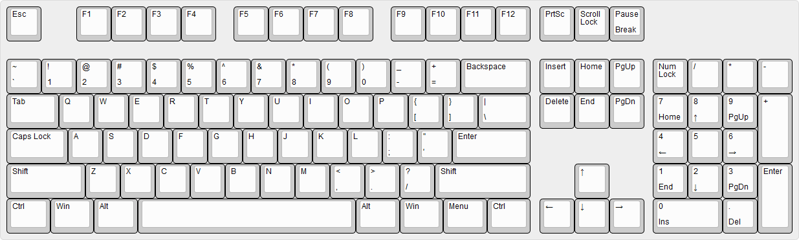
100% Layout

Slide 21
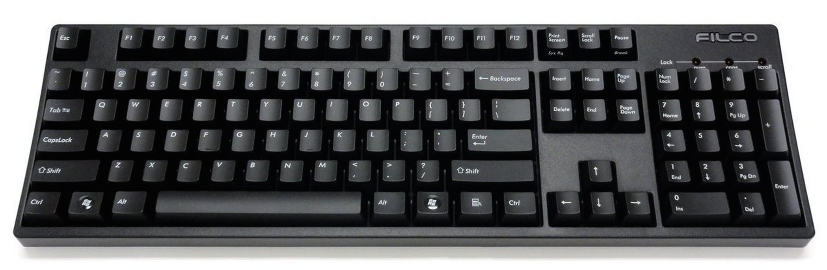
100% Layout

Slide 22
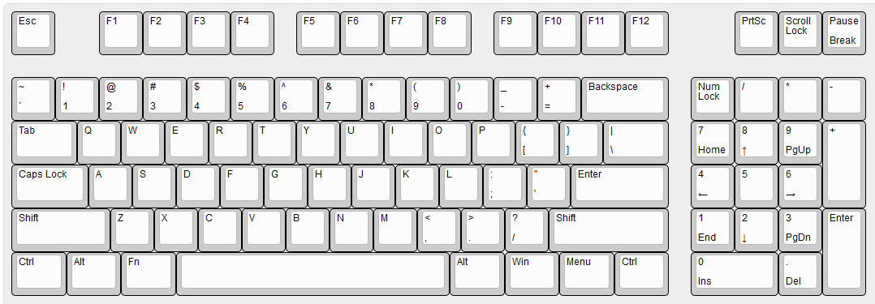
90% Layout

Slide 23
90% Layout

Slide 24
90% Layout

Slide 25
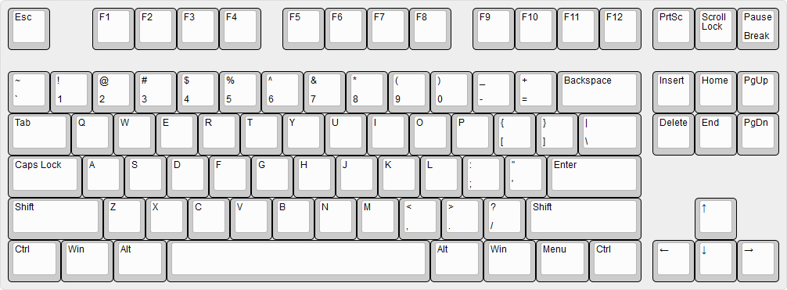
80% Layout

Slide 26
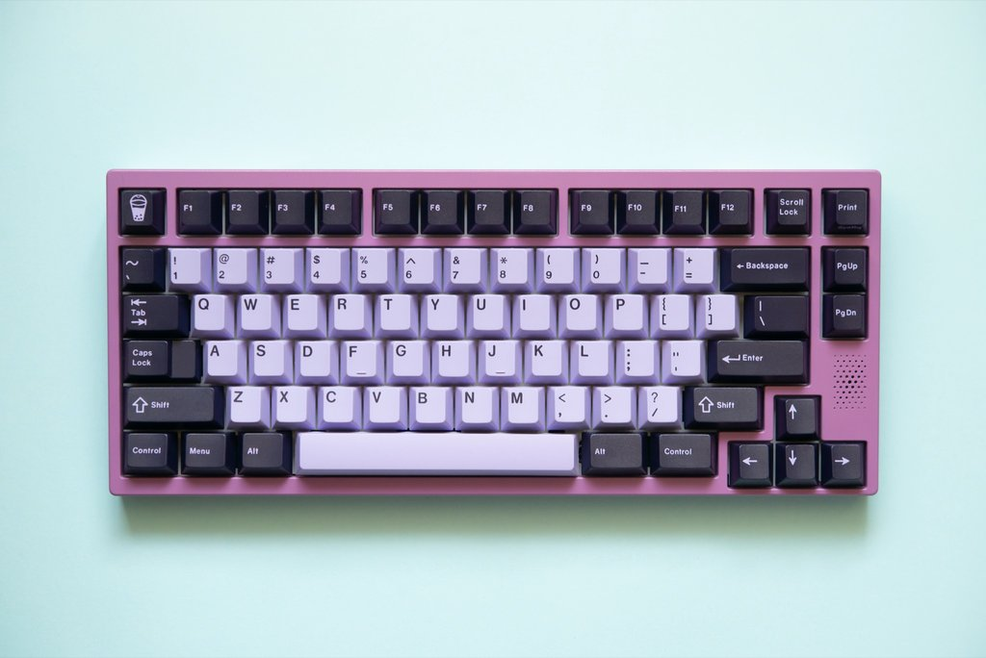
80% Layout

Slide 27
80% Layout

Slide 28
65% Layout

Slide 29
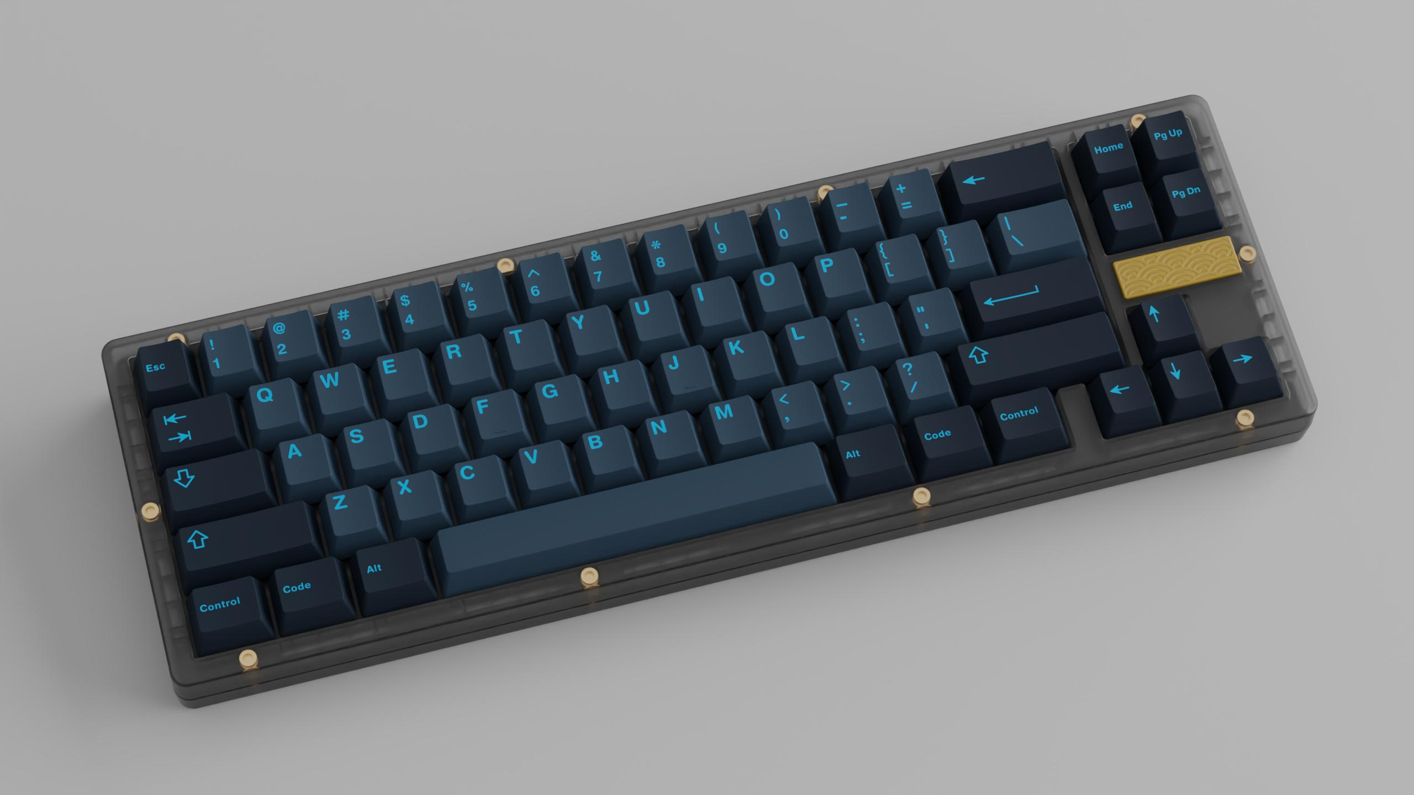
65% Layout

Slide 30
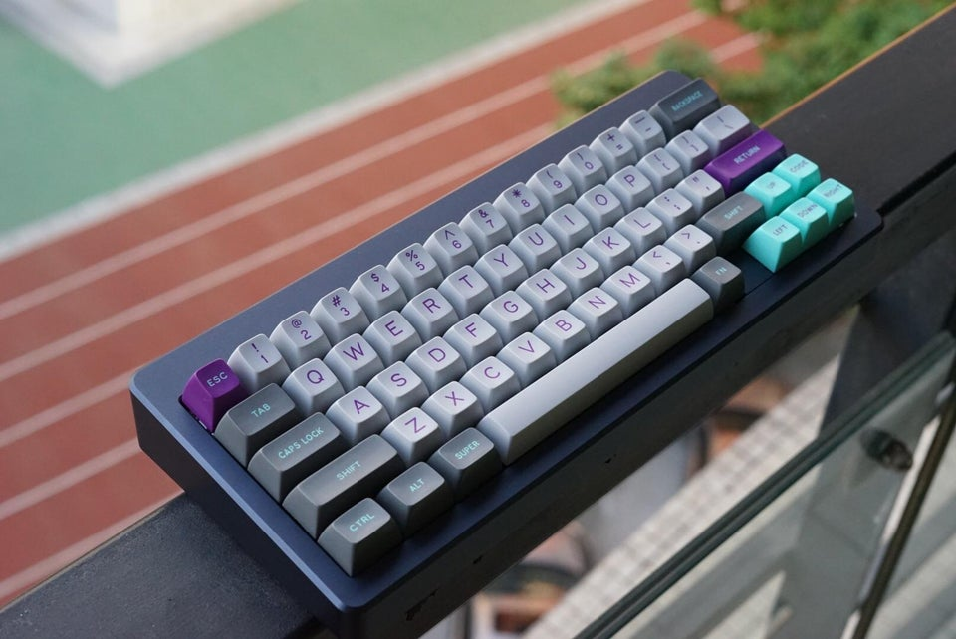
60% Layout

Slide 31
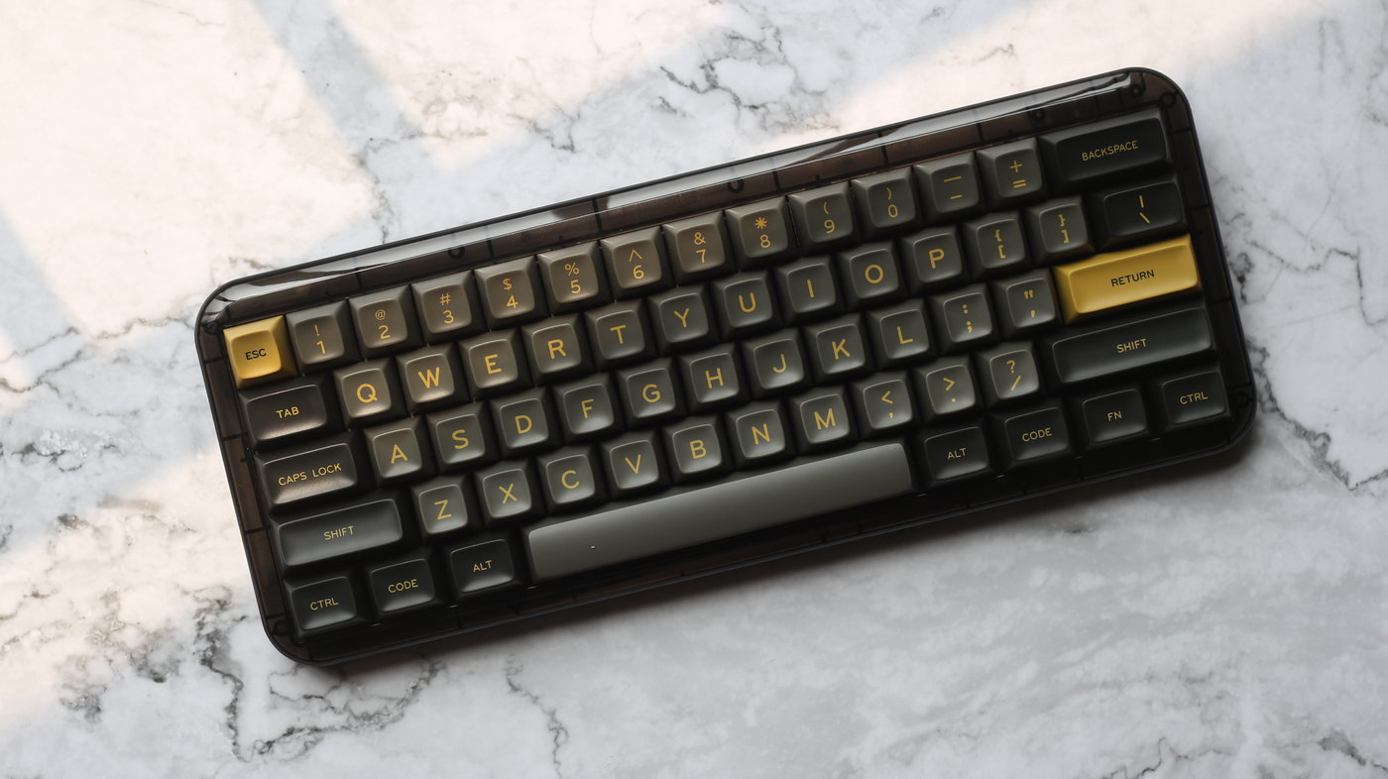
60% Layout

Slide 32
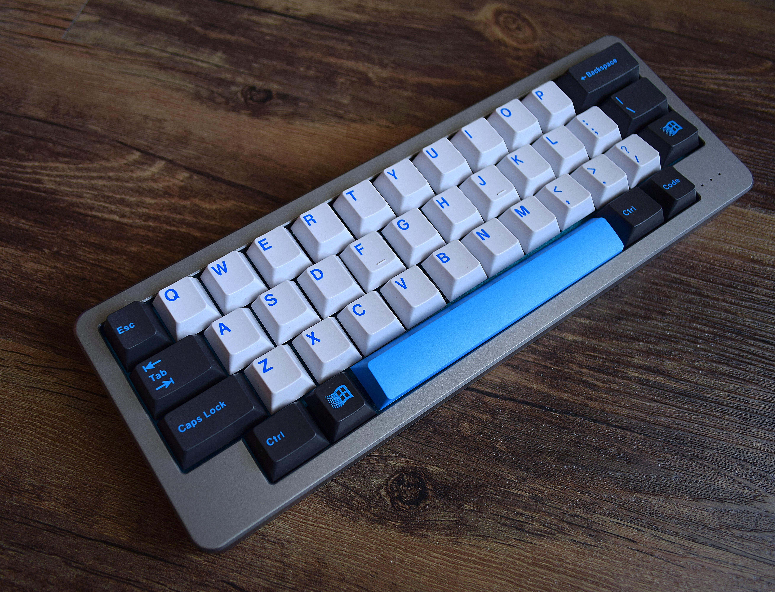
40% Layout

Slide 33
Keycaps
There are two main materials of keycap: ABS, PBT
ABS: smooth, soft;
PBT: textured, durable;
There are two main craft of keycap:
Double-Shot: only two colors, clear and bright color, durable, expensive;
Dye-Sublimation: limit of color selection;

Slide 34
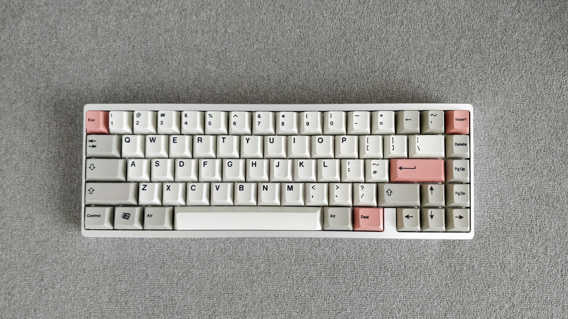
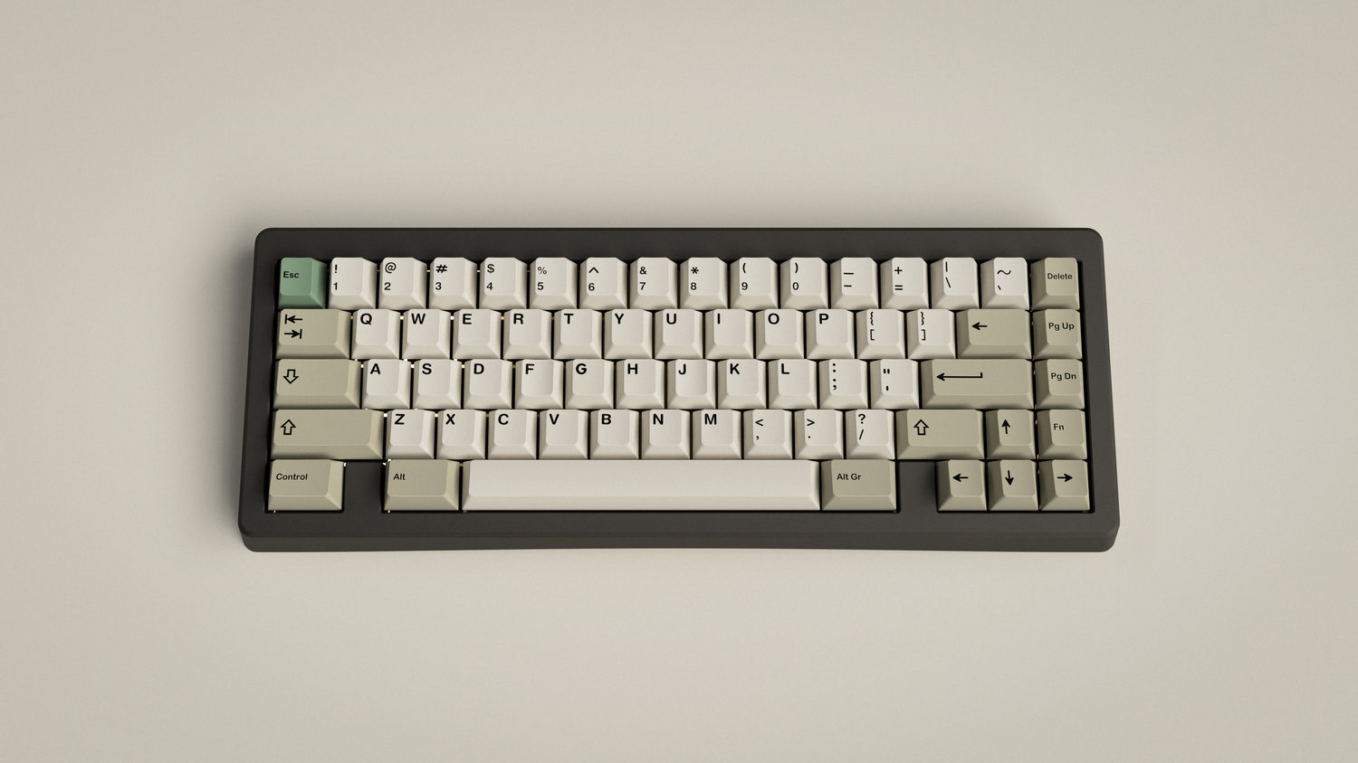
Keycaps
EPBT 9009
Dye-Sublimation
PBT
GMK 9009
Double-shot
ABS

Slide 35
Switches
There are three types of switches:
Linear (Cherry MX Red 45g, Cherry MX Black 60g)
Tactile (Cherry MX Brown 55g)
Cliky (Cherry MX Blue 60g)

Slide 36
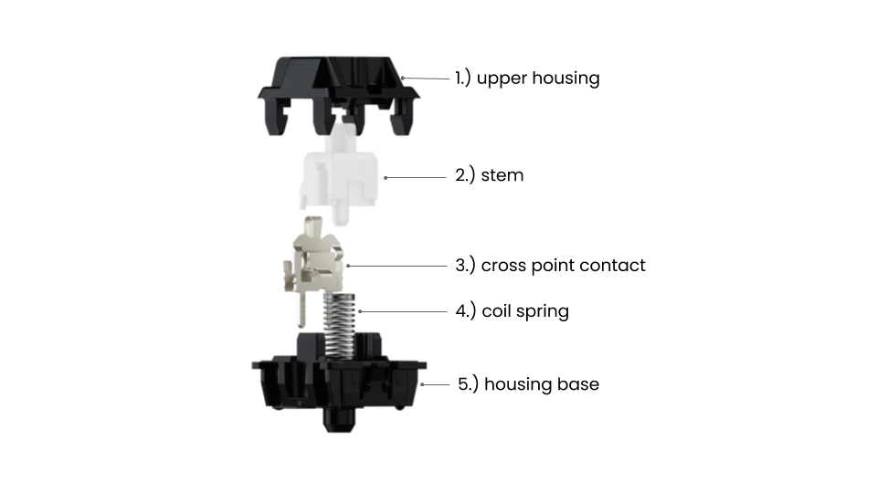
Switches
(zh: 上盖)
(zh: 轴心)
(zh: 金属触点弹片)
(zh: 弹簧)
(zh: 下盖)

Slide 37
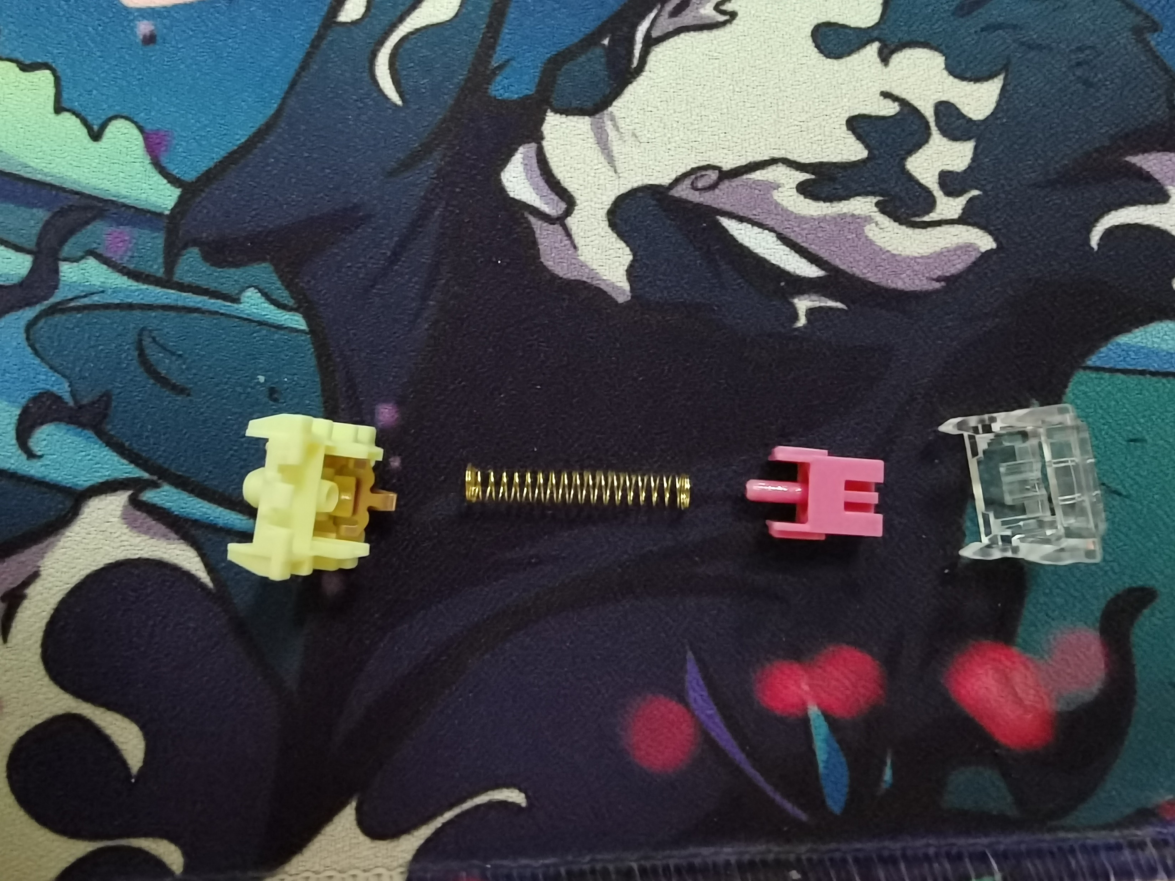
Switches
TTC Gold Pink Switch 37g

Slide 38
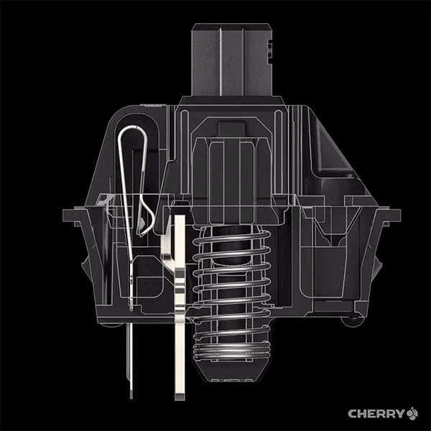
Linear

Slide 39
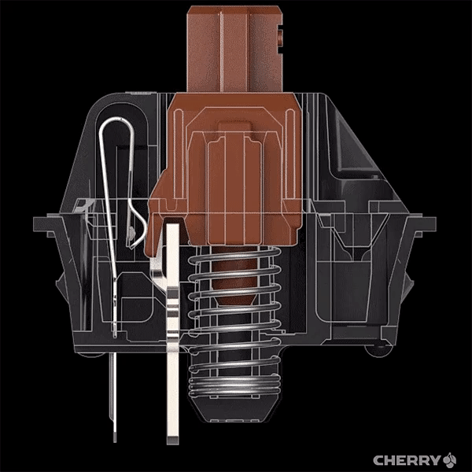
Tactile

Slide 40
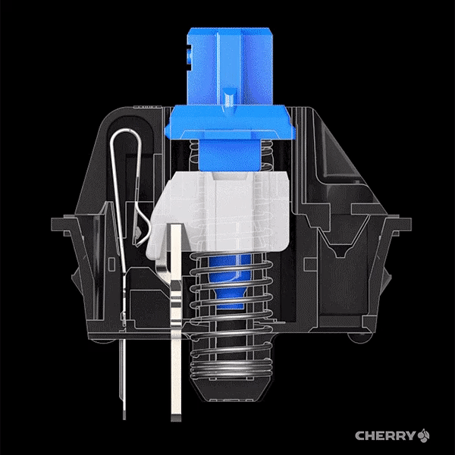
Clicky

Slide 41
Dummy Switch – (zh: 卫星轴)

Slide 42
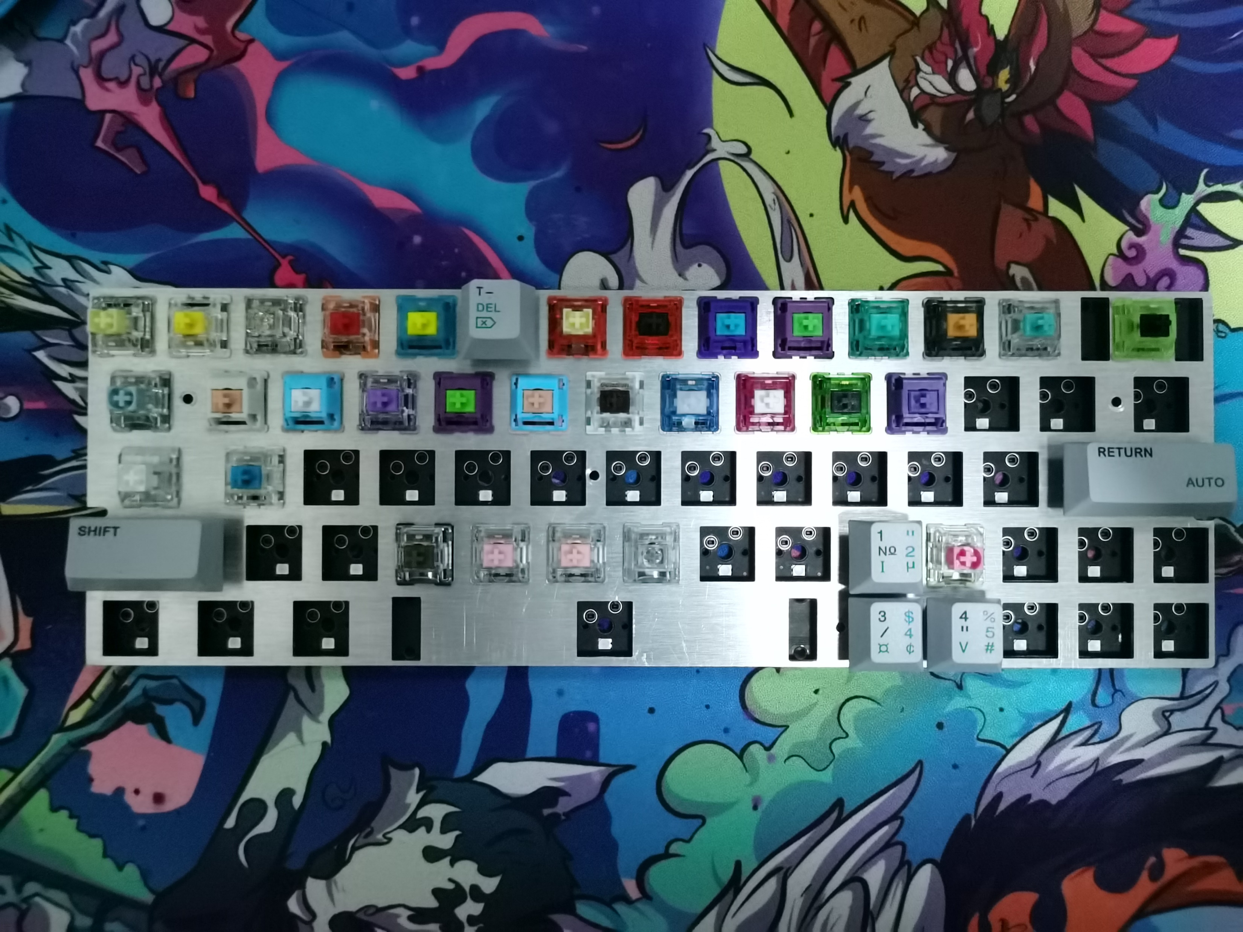

Example
First Line – Linear Switches
Al position plate
Second Line – Tactile Switches
Third Line – Clicky Switches
Raw Dummy
Processed Dummy
Silent Switches

Slide 43
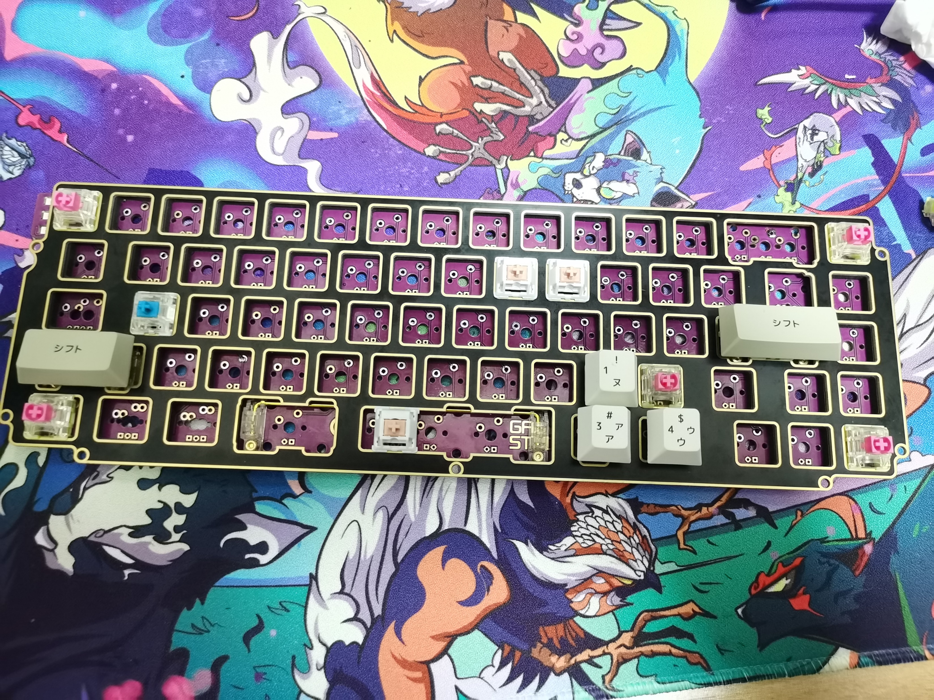
Example
First Line – Linear Switches
Second Line – Tactile Switches
FR4 position plate
Third Line – Clicky Switches
Processed Dummy
Processed Dummy

Slide 44
own

Slide 45
own

Slide 46
Thank you

Slide 47
在目前桌面工作变得越来越密集的当下, 键盘成为了非常重要的生产力, 与此同时键盘也成为了一种个性化的表达方式, 可以看到的是客制化键盘是风格迥异的, 可能上述几款你们可能也不太喜欢, 但是我想传达的意思是, 客制化键盘提供了这种变化的可能, 提供了一种个性表达的平台。当然了, 客制化键盘之所以叫做客制化, 是因为其中透露着一种极客精神, 除了华丽的外表之外, 科
加工精度要求相对高, 不然由于只是使用泡棉来卡住定位板, 如果无法缩小缝隙结构就会不稳定。

